Slide 1


Case Study: VFD in Closed Loop Control of Rotatory Equipment
Applications of VFD in Industrial Automation
Student: Mohamed Sabiq
Course: M.Tech Automation & Robotics
Reg No: RA2512053010005

Slide 2




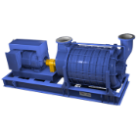
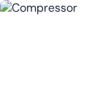
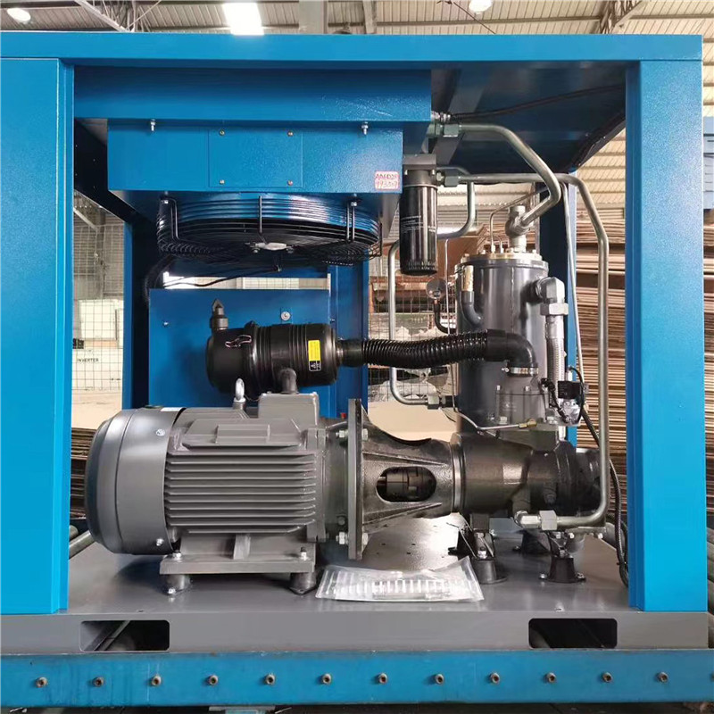
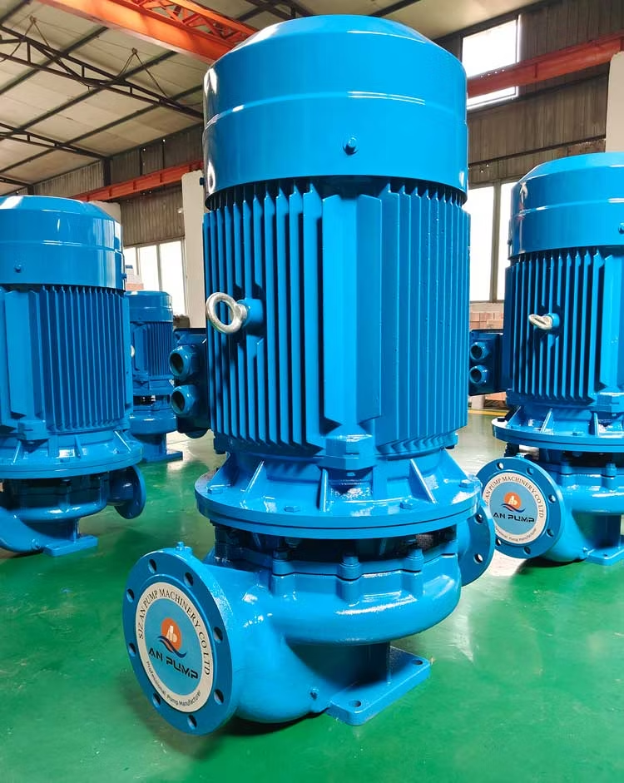
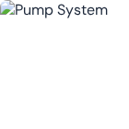
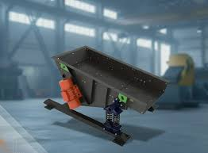

Applications of Closed Loop VFD Control
Oxidation Blower
Air Compressor
Controls airflow in wastewater treatment using DO sensor feedback.
Maintains constant pressure using pressure sensor feedback loop.
→
Maintains dissolved oxygen levels
→
Automatic speed variation
→
Adjusts speed based on demand
→
Stable pressure output
→
Reduces energy consumption
→
Reduced mechanical wear
→
Improves process efficiency
→
Energy efficient operation
Pump System
Vibrating Feeder
Controls flow/pressure in water systems using feedback sensors.
Ensures uniform material feeding through precise speed control.
→
Maintains constant flow/level
→
Consistent material flow
→
Prevents overflow/dry run
→
Adjustable feeding rate
→
Saves electrical power
→
Reduced material wastage
→
Ensures smooth operation
→
Improved plant automation

Slide 3

Thank You
Any Questions?

